Slide 1

Web scraping to gain company insights
08/07/2024

Slide 2
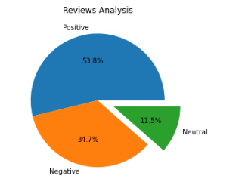
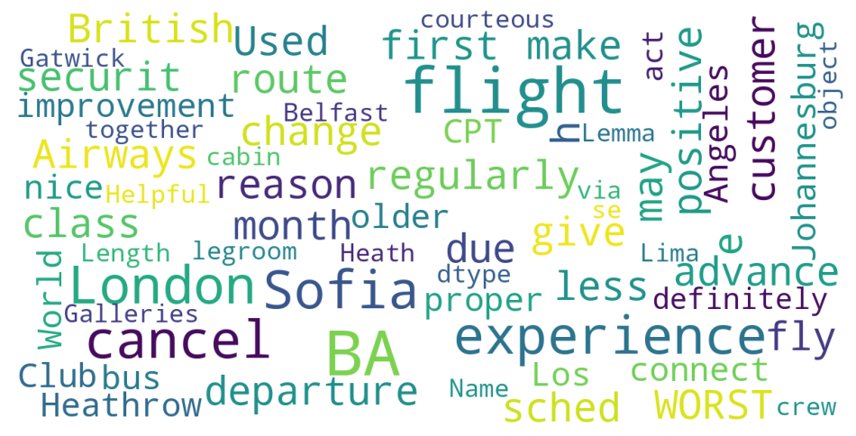
INSIGHTS FROM CUSTOMER REVIEWS
From cleaning 1000 reviews given by the customers, we obtained
Positive Reviews - 471
Negative Reviews - 421
Neutral Reviews – 108
Word cloud of keywords used in reviews

